Slide 1
Inside the LLM Brain: Tracing Multi-Agent Workflows with Neo4j

Slide 2

Problem : Agent is Broken - Why is it ?
Infinite Loops: The agent gets stuck in a reasoning cycle with no exit condition.
Tool Misfires: It calls the wrong function with the wrong parameters, and the error is buried in logs.
Unexpected Detours: It makes a logical leap that seems irrational, derailing the entire workflow.
Memory Blackouts: Why did it forget a critical piece of context from three steps ago?
We are flying blind. Traditional logging and monitoring show what happened, but never why.

Slide 3
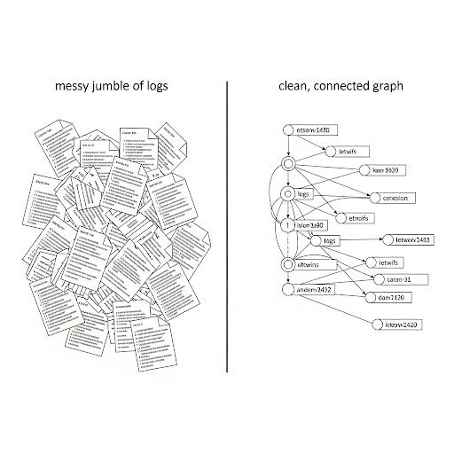
Solution : A Graph-Native Trace
Capture Everything: Every hop, tool call, memory access, and intermediate thought becomes a node.
Connect the Dots: The relationships between these actions—CALLS, LEADS_TO, USES_MEMORY—become edges.
Query the "Why": Use the power of graph traversal to instantly find the root cause of any failure.
Graph Trace transforms an opaque run into an explainable, queryable, and visual map of the agent's mind.

Slide 4
High Level Flow
Layer 1: The Agent System
Your existing LLM agent framework (e.g., LangChain, Llama Index, custom).
Key Requirement: Instrument it to emit key events (thought, action, result).
Layer 2: The Neo4j Observer
This is a lightweight middleware or library.
Its Job: Listen for agent events and transform them in real-time into Cypher MERGE statements.
It ensures new events are connected to the ongoing execution trace.
Layer 3: Neo4j Graph Database
The single source of truth for every agent run.
Stores the entire execution graph for historical analysis, auditing, and comparison.
Feedback Loop: Insights from querying the graph (Layer 3) can be fed back to improve the agent's prompts or logic (Layer 1).

Slide 5
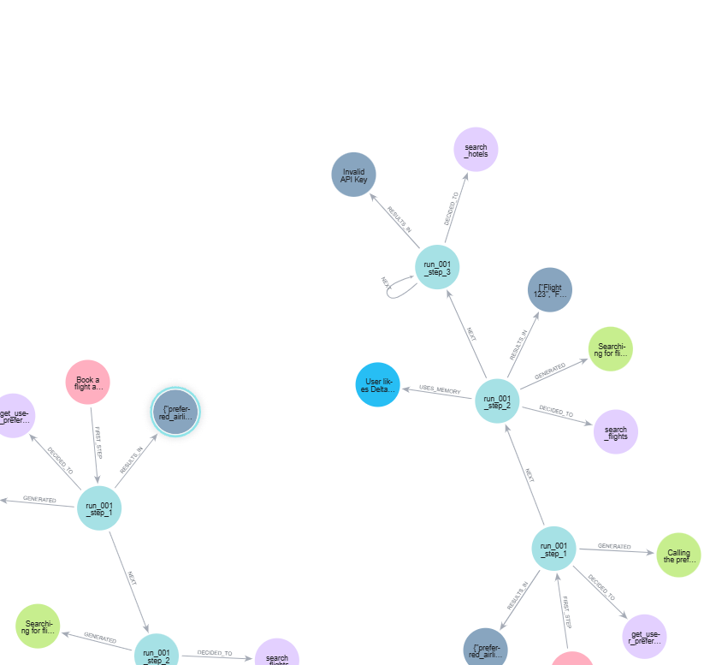
View of Components of Trace
Node Types:
(:AgentRun) - The unique instance of a task. {id: 'xyz', goal: 'Book a flight to NYC'}.
(:Step) - A step in the chain. {id: 1, timestamp: '12:05:01', thought: 'I need to find user preferences'}.
(:Tool) - A function it can call. {name: 'get_user_prefs', parameters: '{}'}.
(:Memory) - A piece of context from vector store or past runs.
(:Output) - The final result or an error. {error: 'Invalid API key'}.
Relationship Types:
(:Step)-[:GENERATED]->(:Thought) - The LLM's internal reasoning.
(:Step)-[:DECIDED_TO]->(:Tool) - The decision to take an action.
(:Step)-[:USES_MEMORY]->(:Memory) - Recalling context.
(:Step)-[:NEXT]->(:Step) - The chronological flow.
(:Step)-[:RESULTS_IN]->(:Output) - The outcome, good or bad.
The Power: This schema allows us to ask complex questions about causality and flow.

Slide 6
Demo
Will be updated

Slide 7
Q&A

Slide 8
Conclusion
Explainability: Go from "it failed" to "here is the precise step where it went wrong and why."
Auditability: Maintain a complete, immutable record of every agent decision for compliance and review.
Faster Debugging: Reduce debugging time from hours to minutes with precise graph queries.
Continuous Improvement: Use the collected graph data to identify weak spots and improve your agent's prompts and logic over time.
Call to Action: Stop debugging in the dark. Start modeling your agent's reasoning with Neo4j.

